Slide 1

Major Project Presentation
Software Maintainability Prediction Using Machine Learning
Submitted By: Submitted To:
Rahul Chaudhry Dr Anuradha Chug
70716403216
B.Tech CSE (8th Sem)
Guru Gobind Singh Indraprastha University
University School of Information, Communication & Technology

Slide 2
Contents
Objective
Project Benefits
Introduction
Research Methodology
Dataset
Models Description
Prediction Accuracy Measures
Results
Conclusion
Future Direction

Slide 3
Objective
The main purpose of this project is to find a robust machine learning model that can work accomplishes the task of prediction of software maintainability cost, based on a combination of features that describes the software so that the user saves the time and money in maintaining the software.

Slide 4
Project Benefits
It helps in keeping future maintenance effort under control.
It provides managers with information for more effectively planning the use of valuable resources.
It guides about maintenance process efficiency.
It enables the developers to identify the determinants of software quality so that they can improve design and coding.
It helps project managers in comparing the productivity and costs among different projects.

Slide 5
Introduction
‘Software maintainability’ is defined as the ease with which a software system or component can be modified to correct faults, improve performance or other attributes, or adapt to a changed environment.
Data shows that the cost associated to maintain one line of source code is 10 times the cost of initial development of that line.
‘‘Ease of maintainability’’ is not only to reduce cost but also to ascertain whether maintenance of that product is worthwhile or not.

Slide 6
The work regarding Software Maintainability Prediction is based on applying different machine learning algorithms on software models and providing a comparative study between the different software metrics and machine learning algorithms.
Machine learning is an application of artificial intelligence (AI) that provides systems the ability to automatically learn and improve from experience without being explicitly programmed.
Machine learning focuses on the development of computer programs that can access data and use it to learn for themselves.

Slide 7
Research Methodology
Data Collection and preprocessing of datasets which includes missing value treatment, cleaning, integration and transformation
Feature sub Selection and Principal Component Analysis
Selection of machine learning techniques to be used in current study and development of prediction model
Selection of prediction accuracy measures
Compare the performance of the Machine learning techniques and their mean ranking as per the accuracy measures
Decision Tree
SVM (Support Vector Machine)
Logistic Regression
Ridge Regression
GRNN (General regression neural network )
PNN (Probablistic Neural Network)
R Squared
MAE (Mean Absolute Error)
Lasso regression
K nearest neighbours
RMSE (Root Mean Square Error)
Bayesian Regression

Slide 8
Dataset
In our project the use two most popular object oriented maintainability datasets : UIMS and QUES datasets.
The UIMS dataset contains class-level metrics data collected from 39 classes of a user interface management system.
The QUES dataset contains the same metrics collected from 71 classes of a quality evaluation system.
Both systems were implemented in Ada.
Both datasets consist of eleven class-level metrics: ten independent variables (WMC, DIT, NOC, RFC, LCOM, MPC, DAC, NOM, SIZE1 and SIZE2 )and one dependent variable(CHANGE).

Slide 9
Dataset description
WMC (Weighted Methods Per Class) | The sum of McCabe’s cyclomatic complexities of all local methods in a class. Let a class K1 with method M1…… Mn that are defined in the class.
DIT (Depth of Inheritance Tree) | The depth of a class in the inheritance tree where the root class is zero.
NOC (Number of Children) | The number of child classes for a class. It counts number of immediate sub classes of a class in a hierarchy.
RFC (Response for a Class) | The number of local methods plus the number of non local methods called by local methods.
LCOM (Lack of Cohesion of Methods) | The number of disjoint sets of local methods. Each method in a disjoint set shares at least one instance variable with at least one member of the same set.
MPC (Message Passing Coupling) | The number of messages sent out from a class.
DAC (Data Abstraction Coupling) | The number of instances of another class declared within a class.
NOM (Number of Methods) | The number of methods in a class.
SIZE1 (Lines of code) | The number of lines of code excluding comments.
SIZE2 (Number of properties) | The total count of the number of data attributes and the number of local methods in a class.
CHANGE (Number of lines changed) | The number of lines added and deleted in a class change of the content is counted as two.

Slide 10
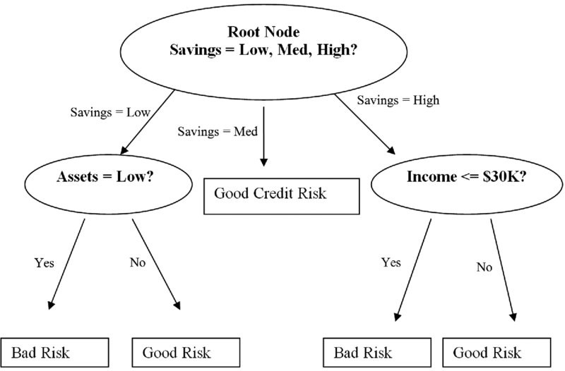
Models Description
Decision tree - It is a decision support tool that uses a tree-like graph or model of decisions and their possible consequences. A decision tree is a flowchart-like structure in which each internal node represents a “test” on an attribute, each branch represents the outcome of the test, and each leaf node represents a class label.

Slide 11
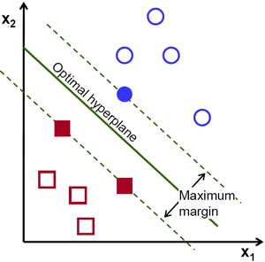
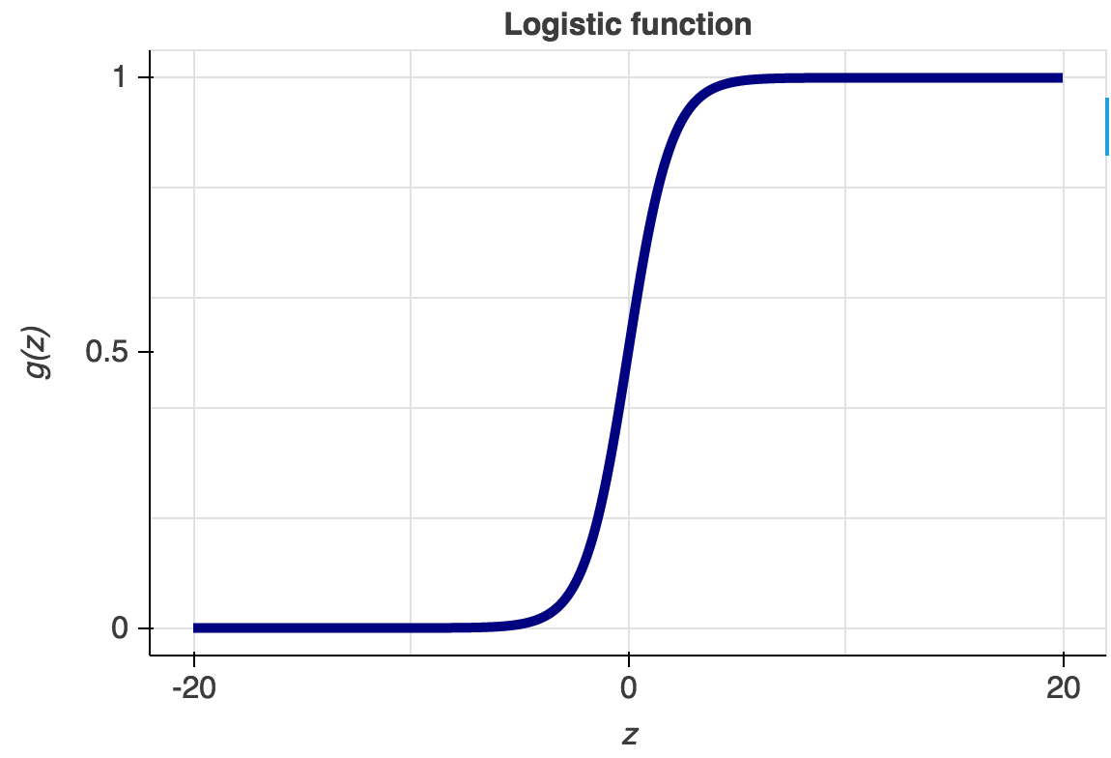
Support Vector – It is an algorithm that is specified to find a hyper plane in an N-dimensional space(N — the number of features) that distinctly classifies the data points.
Logistic Regression - Logistic regression is a statistical model that in its basic form uses a logistic function to model a binary dependent variable. In regression analysis, logistic regression (or logit regression) is estimating the parameters of a logistic model

Slide 12
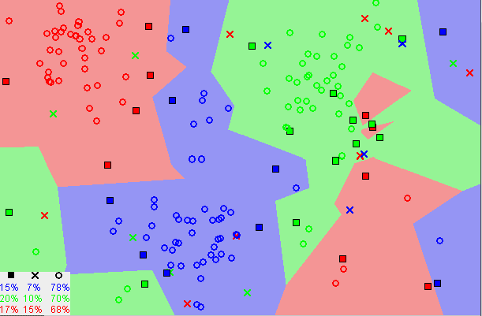
K-Nearest Neighbors - The KNN algorithm assumes that similar things exist in close proximity. In other words, similar things are near to each other.
Ridge Regression- Ridge regression is an extension for linear regression. It is implemented by imposing a penalty on the size of the coefficients when the data leads to over fitting a model and failure to find unique solutions.
Lasso Regression - Lasso is another extension built on regularized linear regression, but with a small twist. The only difference from Ridge regression is that the regularization term is in absolute value. Lasso method overcomes the disadvantage of Ridge regression by not only punishing high values penalty but actually setting them to zero if they are not relevant which creates a huge difference due to which we end up with fewer features.

Slide 13
Bayesian Regression- In the Bayesian viewpoint, we formulate linear regression using probability distributions rather than point estimates. The response, y, is not estimated as a single value, but is assumed to be drawn from a probability distribution.
General Regression Neural Network -The general regression neural network (GRNN) is a single-pass neural network which uses a Gaussian activation function in the hidden layer. GRNN consists of input, hidden, summation, and division layers.
Probabilistic Neural Network - A probabilistic neural network (PNN) is a feed forward neural network, which is widely used in classification and pattern recognition problems. In the PNN algorithm, the parent probability distribution function (PDF) of each class is approximated, the class probability of a new input data is estimated and Bayes’ rule is then employed to allocate the class with highest posterior probability to new input data

Slide 14

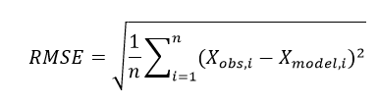
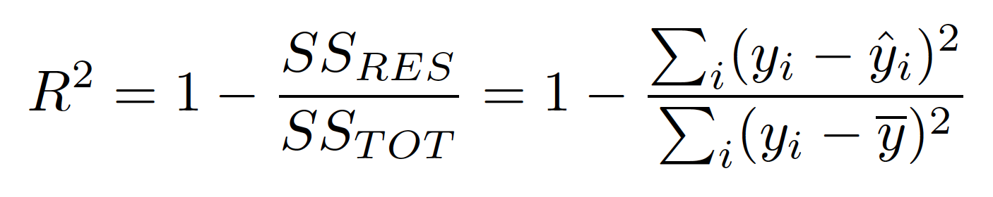
Prediction Accuracy Measures
Mean Absolute Error (MAE) - MAE is an arithmetic average of the absolute errors, where is the prediction and the true value.
Root Mean Square Error (RMSE) - RMSE is defined as the square root of differences between predicted values and observed values.
R Squared Error – It is the proportion of the variance in the dependent variable that is predictable from the independent variable(s).
Sum of squared errors of our regression model (SSres) Sum of squared errors (SStot)

Slide 15
Results

Slide 16
Conclusions
The prediction performance of the machine learning algorithms based models were assessed and compared with prevailing models in terms of R Squared values, MAE values and RMSE values.
It was found that KNN and Ridge Regression model outperformed the prevailing models as the least RMSE value is recorded. As far as R Squared values are concerned, KNN and Ridge Regression models are significantly better over others on the QUES dataset
Whereas GRNN and PNN gave compelling results of R Squared values on both the datasets. Thus, it is concluded GRNN and PNN are indeed a very useful modeling technique and it could be used as a sound alternative for the prediction of software maintainability.

Slide 17
Future Directions
The present investigation depended on two business programming datasets UIMS and QUES created in ADA, therefore we there can be research in the same datasets created in different programming
Further research can be arranged trying to join these models with other information mining procedures to create expectation models which can gauge the viability of programming all the more precisely with least accuracy mistakes on other programming dialects.

Slide 18
Thank You!

